Slide 1
L-2: AD-2
CSE 4131

Slide 2
Outline

Slide 3
Introduction
Similar to divide-and-conquer method: solves problems by combining the solutions to subproblems.
Divide-and-conquer algorithms partition the problem into independent subproblems, solve the subproblems recursively, and then combine their solutions to solve the original problem.
dynamic programming is applicable when the subproblems are not independent, that is, when subproblems share sub-subproblems.
A dynamic-programming algorithm solves every subproblem just once and then saves its answer in a table, thereby avoiding the work of recomputing the answer every time the subproblem is encountered.

Slide 4
Dynamic programming is a technique for efficiently implementing a recursive algorithm by storing partial results.
The development of a dynamic-programming algorithm can be broken into a sequence of four steps.
Step:1 Characterize the structure of an optimal solution.
Step:2 Recursively define the value of an optimal solution.
Step:3 Compute the value of an optimal solution in a bottom-up fashion.
Step:4 Construct an optimal solution from computed information.

Slide 5
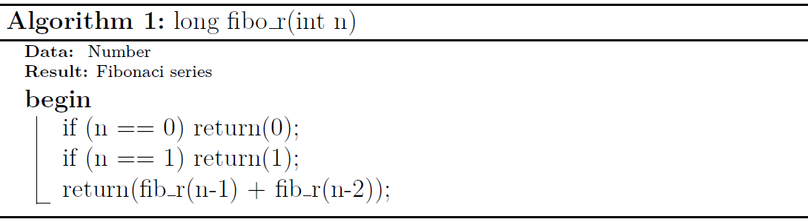
Understanding Dynamic Programming
Recursive program for Fibonacci Numbers

Slide 6
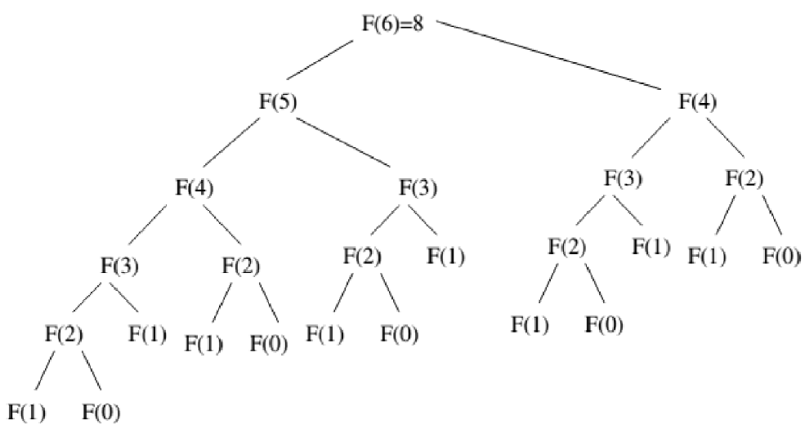
Recursion tree for execution of fib(8)
We can see that the function fib(3) is being called 3 times.
If we would have stored the value of fib(3), then instead of computing it again, we could have reused the old stored value.

Slide 7
There are following two different ways to store the values so that these values can be reused: a) Memoization (Top Down) b) Tabulation (Bottom Up)

Slide 8
Memoization (Top Down)
The memoized program for a problem is similar to the recursive version with a small modification that it looks into a lookup table before computing solutions.
We initialize a lookup array with all initial values as NIL.
Whenever we need the solution to a subproblem, we first look into the lookup table. If the precomputed value is there then we return that value, otherwise, we calculate the value and put the result in the lookup table so that it can be reused later.

Slide 9
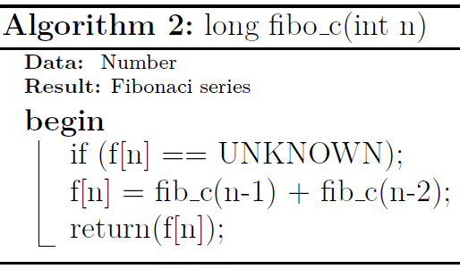
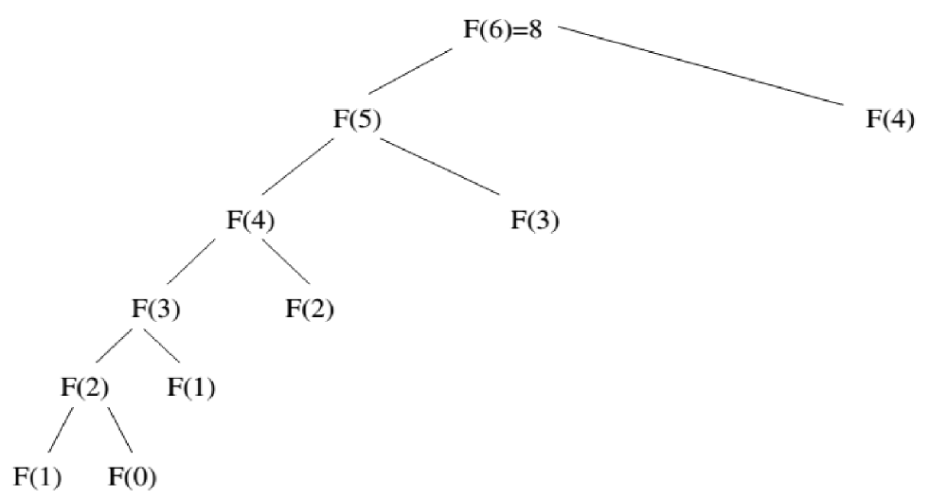
Memoized version for nth Fibonacci Number
Recursion tree for execution of fib(8)

Slide 10
Tabulation (Bottom Up)
The tabulated program for a given problem builds a table in bottom up fashion and returns the last entry from table.
For example, for the same Fibonacci number, we first calculate fib(0) then fib(1) then fib(2) then fib(3) and so on. So literally, we are building the solutions of subproblems bottom-up.

Slide 11
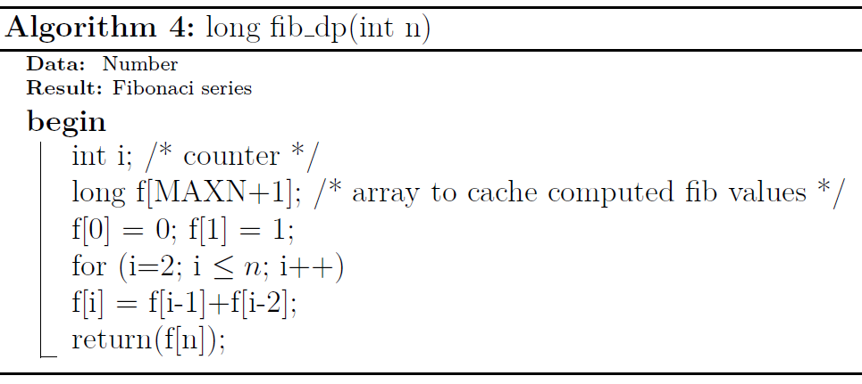
Tabulation version for nth Fibonacci Number

Slide 12
When to apply
The two main properties of a problem that suggests that the given problem can be solved using Dynamic programming.
Optimal Substructure
Overlapping Subproblems

Slide 13
Optimal Substructure
A given problems has Optimal Substructure Property if optimal solution of the given problem can be obtained by using optimal solutions of its subproblems.

Slide 14
Overlapping Subproblems:
Like Divide and Conquer, Dynamic Programming combines solutions to sub-problems.
Dynamic Programming is mainly used when solutions of same subproblems are needed again and again.
In dynamic programming, computed solutions to subproblems are stored in a table so that these don’t have to be recomputed.
So Dynamic Programming is not useful when there are no common (overlapping) subproblems because there is no point storing the solutions if they are not needed again. For example, Binary Search doesn’t have common subproblems.

Slide 15
Binomial Coefficient

Slide 16
Binomial Coefficient Using Dynamic Programming
A binomial coefficient C(n, k) can be defined as the coefficient of x^{k} in the expansion of (1 + x)^{n}.
A binomial coefficient C(n, k) also gives the number of ways, disregarding order, that k objects can be chosen from among n objects more formally, the number of k-element subsets (or k-combinations) of a n-element set.
The Problem Write a algorithm that takes two parameters n and k and returns the value of Binomial Coefficient C(n, k). For example, your function should return 6 for n = 4 and k = 2, and it should return 10 for n = 5 and k = 2.

Slide 17
1) Optimal Substructure
Recursive Solution
The value of C(n, k) can be recursively calculated using the following standard formula for Binomial Coefficients.
C(n, k) = C(n-1, k-1) + C(n-1, k)
C(n, 0) = C(n, n) = 1
// Returns value of Binomial Coefficient C(n, k)
int binomialCoeff(int n, int k)
{
// Base Cases
if (k > n)
return 0;
if (k == 0 || k == n)
return 1;
// Recur
return binomialCoeff(n - 1, k - 1)
+ binomialCoeff(n - 1, k);
}

Slide 18
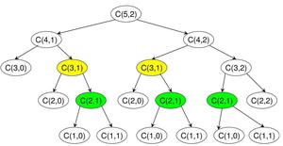
2) Overlapping Subproblems
It should be noted that the above function computes the same subproblems again and again.
See the following recursion tree for n = 5 an k = 2.
The function C(3, 1) is called two times. For large values of n, there will be many common subproblems.

Slide 19
Dynamic Programming based implementation
Algorithm Binomial(n, k)
for i ← 0 to n do // fill out the table row wise
for j = 0 to min(i, k) do
if j==0 or j==i then
C[i, j] ← 1
else
C[i, j] ← C[i-1, j-1] + C[i-1, j] // recursive relation
return C[n, k]

Slide 20
Matrix Chain Multiplication

Slide 21
Introduction
We are given a sequence (chain) <A₁, A₂, . . . ,A_{n}> of n matrices to be multiplied, and we wish to compute the product A₁, A₂, ... ,A_{n}
Matrix multiplication is associative, and so all parenthesizations yield the same product.
A product of matrices is fully parenthesized if it is either a single matrix or the product of two fully parenthesized matrix products, surrounded by parentheses.

Slide 22
For example, if the chain of matrices is <A₁, A₂, . . . ,A_{n}>, then we can fully parenthesize the product A₁ A₂ A₃ A₄ in five distinct ways:
(A₁ (A₂ (A₃ A₄)))
((A₁ (A₂ A₃)) A₄)
((A₁ A₂) (A₃ A₄))
(A₁ ((A₂ A₃) A₄))
(((A₁ A₂) A₃) A₄)
How we parenthesize a chain of matrices can have a dramatic impact on the cos of evaluating the product.
If A is a p X q matrix and B is a q X r matrix, the resulting matrix C is a p X r matrix.

Slide 23
The time to compute C is dominated by the number of scalar multiplications which is pqr (c_{ij} = c_{ij} + a_{ik}.b_{kj}).
Suppose <A₁, A₂, A₃> are the three matrices with dimensions 10X100, 100X5, and 5X50.
If we multiply like ((A₁ A₂) A₃) then we perform 10X100X5 + 10X5X50 = 7500 scalar multiplications
Else we multiply like (A₁ (A₂ A₃)) then we perform 100X5X50 + 10X100X50 = 75,000 scalar multiplications
Thus, computing the product according to the first parenthesization is 10 times faster.

Slide 24
The Problem
We state the matrix-chain multiplication problem as follows:
Given a chain <A1, A2, . . . ,An> of n matrices, where for i = 1,2, ... ,n, matrix Ai has dimension pi-1Xpi , fully parenthesize the product A1 A2... An in a way that minimizes the number of scalar multiplications.
Note that in the matrix-chain multiplication problem, we are not actually multiplying matrices.
Our goal is only to determine an order for multiplying matrices that has the lowest cost.

Slide 25
Applying dynamic programming
Characterize the structure of an optimal solution.
Recursively define the value of an optimal solution.
Compute the value of an optimal solution.
Construct an optimal solution from computed information.

Slide 26
Notation
Let us adopt the notation A_{i ..j}, where i<=j , for the matrix that results from evaluating the product A_{i} A_{i+1} A_{j}.
For a nontrivial problem (i < j) the product A_{i} A_{i+1} ... A_{j} must be splited between A_{k} and A_{k+1} for some integer k in the range i <= k < j.
The matrices A_{i ..k} and A_{k+1 ..j} is computed first and then they are multiplied to get final product A _{i ..j}.
The cost of parenthesizing this way is the cost of computing the matrix A _{i ..k}, plus the cost of computing A_{k+1} .._{j} , plus the cost of multiplying them together.

Slide 27
Step 1: The structure of an optimal parenthesization
Suppose that to optimally parenthesize A_{i} A_{i+1} . . .A_{j} , we split the product between A_{k} and A_{k+1}.
Then the way we parenthesize the “prefix” subchain A_{i}A_{i+1} . . . A_{k} within this optimal parenthesization of A_{i} A_{i+1} . . . A_{j} must be an optimal parenthesization of A_{i}A_{i+1} . . . A_{k}.
Then the parenthesization A_{i}A_{i+1} . . . A_{k} and A_{k+1}A_{k+2} . . . A_{j} must be optimal. (if not we can choose the which ever is optimal)
Thus, optimal can be build by splitting the problem into two subproblems optimally.
We must ensure that when we have considered all possible places, so that we are sure of having examined the optimal one.

Slide 28
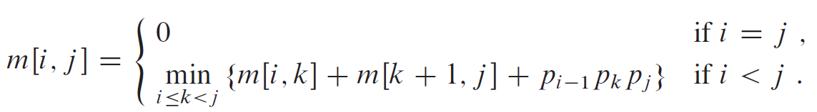
Step 2: A recursive solution
Let m[i, j] be the minimum number of scalar multiplications needed to compute the matrix Ai ..j; thus cost of solving full problem is m[1, n].
m[i, i] = 0 for i = 1, 2, ,n (trivial case)
m[i, j] = sum of cost of computing the product Ai.. k and Ak+1 ..j + cost of multiplying these two matrices together
Each matrix Ai is pi-1 X pi, thus computing the matrix product Ai ..k Ak+1 ..j takes pi-1pkpj scalar multiplications thus
m[i, j] = m[i, k] + m[k+1, j]+pi-1pkpj, Here, k = i, i+1, .., j-1.

Slide 29
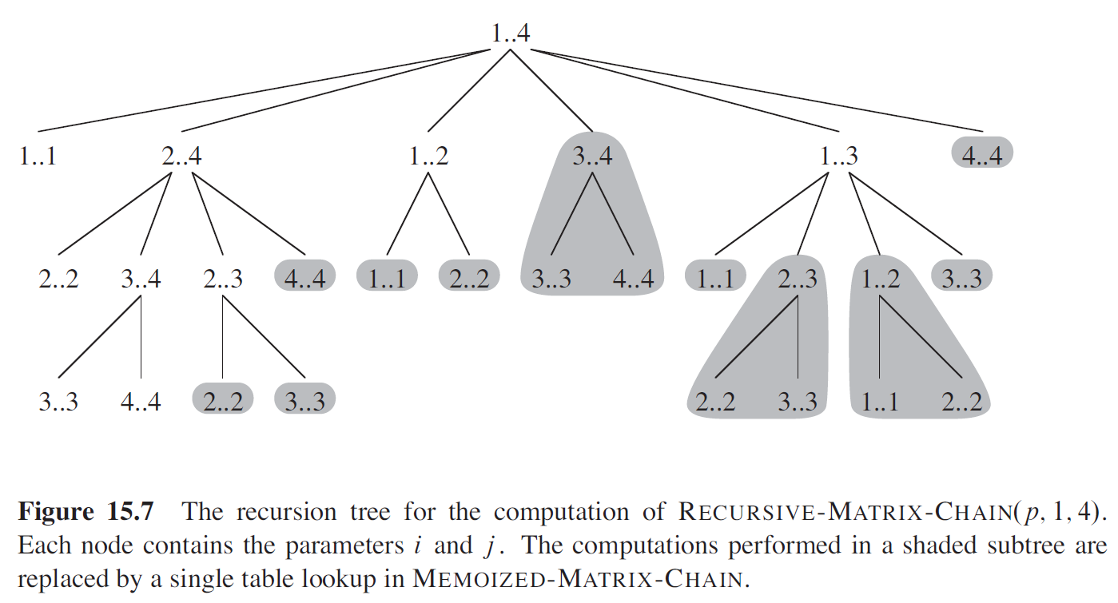

Slide 30
Step 3: Computing the optimal costs
At this point, we could easily write a recursive algorithm based on recurrence.
Observe that we have relatively few distinct subproblems: one subproblem for each choice of i and j satisfying 1 <= i <= j <= n = θ(n²)
A recursive algorithm may encounter each subproblem many times in different branches of its recursion tree.
This property of overlapping subproblems is the second hallmark of when dynamic programming applies.

Slide 31
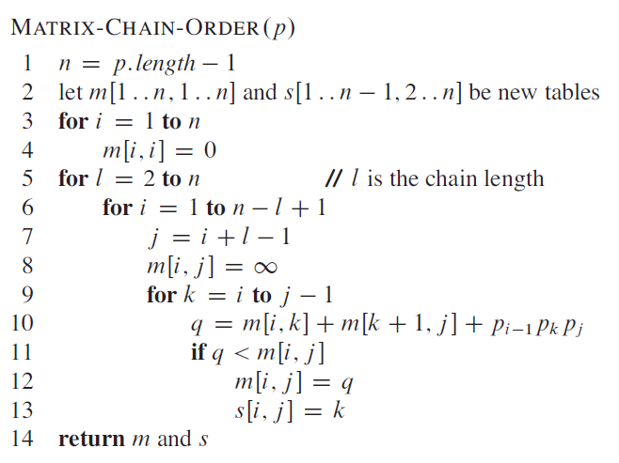
Algorithm based on DP

Slide 32
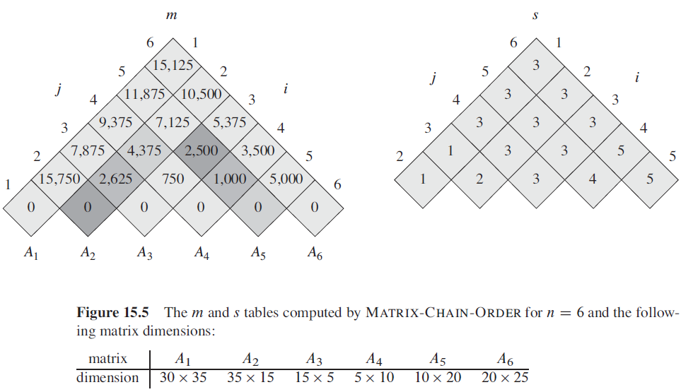
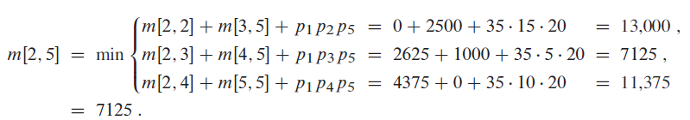
Example

Slide 33
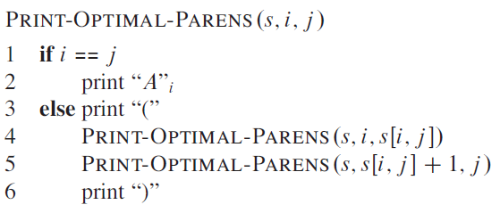
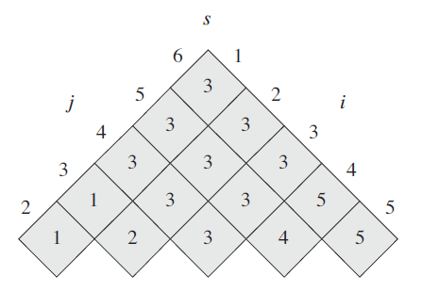
Step 4: Constructing an optimal solution
Although MATRIX-CHAIN-ORDER determines the optimal number of scalar multiplications needed to compute a matrix-chain product, it does not directly show how to multiply the matrices.
The table s[1 ..n-1, 2 ..n ] gives us the information we need to do so.
The initial call PRINT-OPTIMAL-PARENS(s, 1, n)prints an optimal parenthesization of <A1, A2, … An>.
PRINT-OPTIMAL-PARENS(S, 1, 6) prints the parenthesization
(( (A1 (A2 A3)) ((A4 A5) A6)).

Slide 34
Questions
Find an optimal parenthesization of a matrix-chain product whose sequence of dimensions is <5, 10, 3, 12, 5, 50, 6>.

Slide 35
Minimum Length Triangulation

Slide 36
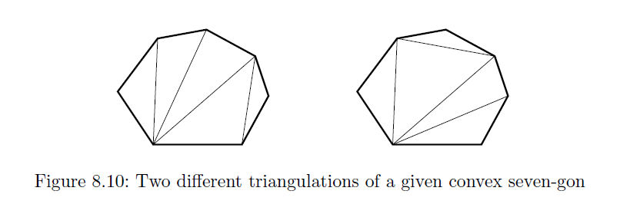
Minimum Length Triangulation
A triangulation of a polygon P = {v₁, . . . , v_{n}, v₁} is a set of nonintersecting diagonals that partitions the polygon into triangles.
We say that the weight of a triangulation is the sum of the lengths of its diagonals.
We seek to find its minimum weight triangulation for a given polygon p.

Slide 37
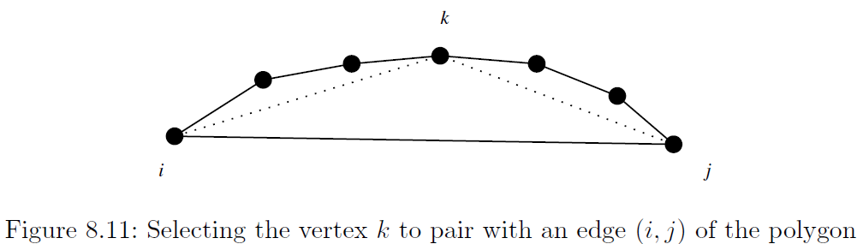
To apply dynamic programming, we need a way to carve up the polygon into smaller pieces.
Observe that every edge of the input polygon must be involved in exactly one triangle.
Turning this edge into a triangle means identifying the third vertex, as shown in Figure below.

Slide 38
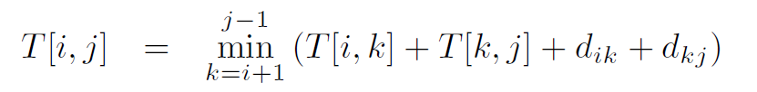
Once we find the correct connecting vertex, the polygon will be partitioned into two smaller pieces, both of which need to be triangulated optimally.
Let T[i, j] be the cost of triangulating from vertex v_{i} to vertex v_{j} , ignoring the length of the chord d_{ij} from v_{i} to v_{j} .
The latter clause avoids double counting these internal chords in the following recurrence:
The basis condition applies when i and j are immediate neighbors, as T[i, i+1] = 0

Slide 39
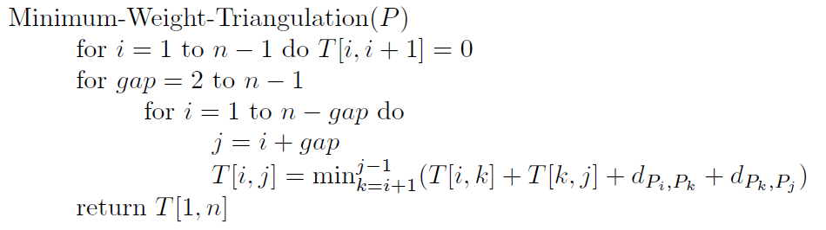
Since the number of vertices in each subrange of the right side of the recurrence is smaller than that on the left side, evaluation can proceed in terms of the gap size from i to j:

Slide 40
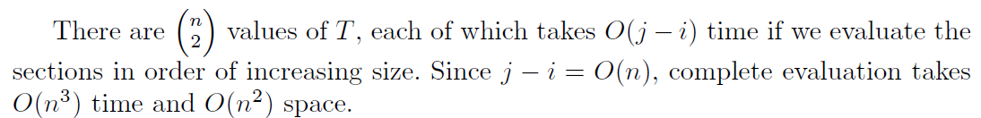

Slide 41
Parsing Context-Free Grammars

Slide 42
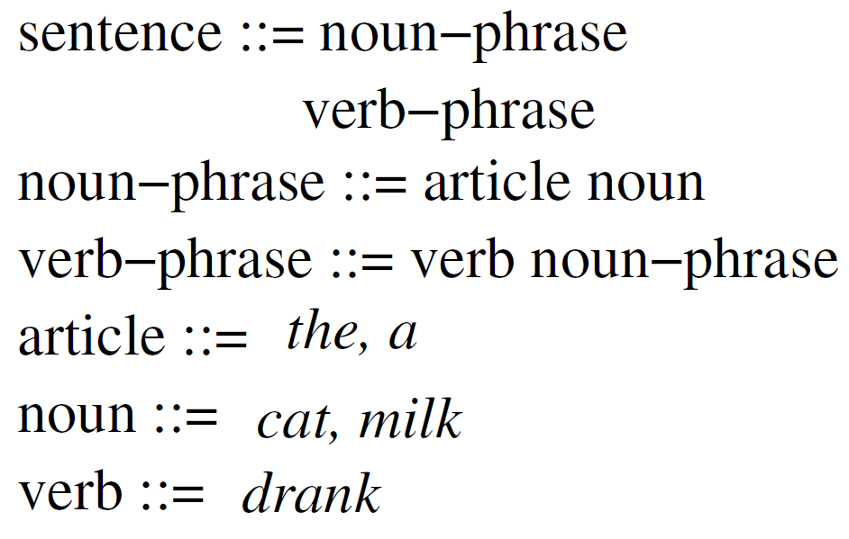
Introduction
Compilers identify whether the given program is legal in the programming language, and reward you with syntax errors if not.
This requires a precise description of the language syntax typically given by a context-free grammar as shown in Figure.
Each rule or production of the grammar defines an interpretation for the named symbol on the left side of the rule as a sequence of symbols on the right side of the rule.
The right side can be a combination of nonterminals (themselves defined by rules) or terminal symbols defined simply as strings, such as “the”, “a”, “cat”, “milk”, and “drank.”

Slide 43
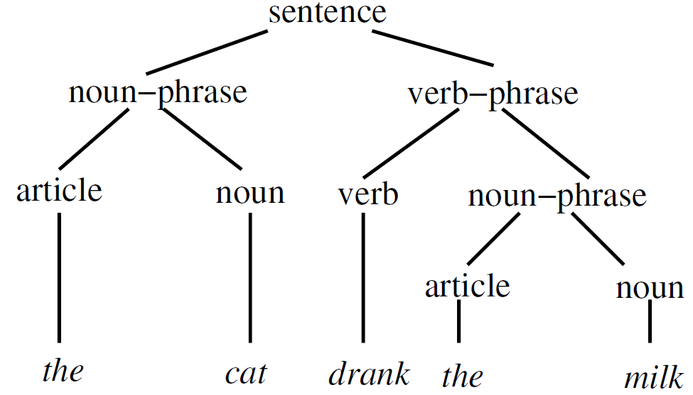
Parsing a given text string S according to a given context-free grammar G is the algorithmic problem of constructing a parse tree of rule substitutions defining S as a single nonterminal symbol of G.
Figure gives the parse tree of a simple sentence using our sample grammar.
We assume that the definitions of each rule are in Chomsky normal form.
This means that the right sides of every nontrivial rule consists of
exactly two nonterminals, i.e. X → Y Z,
or
exactly one terminal symbol, X → α.

Slide 44
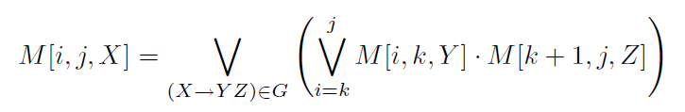
The key observation is that the rule applied at the root of the parse tree (say X → Y Z) splits S at some position i such that the left part of the string (S[1, i]) must be generated by nonterminal Y, and the right part (S[i + 1, n]) generated by Z.
This suggests a dynamic programming algorithm, where we keep track of all of the nonterminals generated by each substring of S.
Define M[i, j, X] to be a boolean function that is true iff substring S[i, j] is generated by nonterminal X.
This is true if there exists a production X → Y Z and breaking point k between i and j such that the left part generates Y and the right part Z.

Slide 45
The one-character terminal symbols define the boundary conditions of the recurrence.
In particular, M[i, i,X] is true iff there exists a production X → α such that S[i] = α.

Slide 46
What is the complexity of this algorithm?
The size of our state-space is O(n²), as there are n(n + 1)/2 substrings defined by (i, j) pairs.
Multiplying this by the number of nonterminals (say v) has no impact on the big-Oh, because the grammar was defined to be of constant size.
Evaluating the value M[i, j,X] requires testing all intermediate values k, so it takes O(n) in the worst case to evaluate each of the O(n²) cells.
This yields an O(n³) or cubic-time algorithm for parsing.

Slide 47
All Pairs Shortest Paths and Floyd-Warshall Algorithm CLRS 25.2

Slide 48
All-pairs shortest paths
Given a weighted directed graph, G(V, E) with a weight function w that maps edges to real-valued weights.
w(u,v) denote the weight of an edge (u,v)
For every pair of vertices u, v, find a shortest path from u to v, where the weight of a path is the sum of the weights of the edges along the path.
Run Dijkstra’s algorithm V times?
O(V E log V) if no negative weights

Slide 49
All-pairs shortest paths
If we allow negative edge weights but no negative-weight cycles
Cannot use Dijkstra’ algorithm
Run Bellman-Ford (the one we did not cover) once for each vertex, which leads to a running time of
for a dense graph.

Slide 50
All-pairs shortest paths
Instead, we will use a dynamic programming solution:
Floyd-Warshall Algorithm
Running time:
Let denote the weight of the shortest path from u to v

Slide 51
Input: adjacency matrix representing G
Assume an adjacency matrix representation
Assume vertices are numbered 1,2,…,n
The input is a n x n matrix representing the edge weights of an n-vertex directed graph

Slide 52
Output?
n x n matrix
Entry will contain the weight of the shortest path from vertex i to vertex j, that is

Slide 53
Example: input
2
W
4
3
1 2 3 4 5
1
2
3
4
5
0 | 3 | 8 | ∞ | -4
∞ | 0 | ∞ | 1 | 7
∞ | 4 | 0 | ∞ | ∞
2 | ∞ | -5 | 0 | ∞
∞ | ∞ | ∞ | 6 | 0
1
8
3
2
-4
1
-5
7
5
4
6

Slide 54
Example: output
2
D
4
3
1 2 3 4 5
1
2
3
4
5
0 | 1 | -3 | 2 | -4
3 | 0 | -4 | 1 | -1
7 | 4 | 0 | 5 | 3
2 | -1 | -5 | 0 | -2
8 | 5 | 1 | 6 | 0
1
8
3
2
-4
1
-5
7
5
4
6

Slide 55
Example: output
2
D
4
3
1 2 3 4 5
1
2
3
4
5
0 | 1 | -3 | 2 | -4
3 | 0 | -4 | 1 | -1
7 | 4 | 0 | 5 | 3
2 | -1 | -5 | 0 | -2
8 | 5 | 1 | 6 | 0
1
8
3
2
-4
1
-5
7
5
4
6

Slide 56
Example: output
2
D
4
3
1 2 3 4 5
1
2
3
4
5
0 | 1 | -3 | 2 | -4
3 | 0 | -4 | 1 | -1
7 | 4 | 0 | 5 | 3
2 | -1 | -5 | 0 | -2
8 | 5 | 1 | 6 | 0
1
8
3
2
-4
1
-5
7
5
4
6

Slide 57
DP Formulation
Intermediate vertices: on a path
any vertex other than the first and the last vertices is called and intermediate vertex.
Let vertices of G be V={1,2,….,n}
Consider a subset {1,2,…,k} of these vertices for some k
Subproblems: limit the set of intermediate vertices on a path from i to j to subset {1,2,…,k}
The path is allowed to pass through only vertices 1 through k

Slide 58
DP Formulation
In the original problem: For any pair of vertices i and j, the intermediate vertices could be drawn from the set {1,…,n}
Define to be the shortest path from i to j such that intermediate vertices on the path are drawn from the set {1,2,…,k}
Matrix

Slide 59
Example
2
4
3
1
8
3
2
14
1
-5
7
5
4
6

Slide 60
Example
2
4
3
1
8
3
2
14
1
-5
7
5
4
6

Slide 61
Example
2
4
3
1
8
3
2
14
1
-5
7
5
4
6

Slide 62
DP Formulation
How to reduce to smaller problems? i.e. how to compute assuming we have already computed ?

Slide 63
DP Formulation
How to reduce to smaller problems? i.e. how to compute assuming we have already computed ?
Two cases:
Case 1: Vertex k is NOT among the intermediate vertices on the shortest path from i to j

Slide 64
DP Formulation
Case 2: Vertex k is an intermediate vertex on the shortest path from i to j
First take the shortest path from i to k using intermediate vertices from the set {1,2,…,k-1}
Then take the shortest path from k to j using intermediate vertices from the set {1,2,…,k-1}
k
i
j

Slide 65
DP Formulation
Base case:
Recursive definition (for k > 0)

Slide 66
Floyd-Warshall Algorithm
Floyd-Warshall(W) {
n = rows[W]
for k=1 to n do
for i=1 to n do
for j=1 to n do
return
}

Slide 67
Example
2
4
3
1 2 3 4 5
1
2
3
4
5
0 | 3 | 8 | ∞ | -4
∞ | 0 | ∞ | 1 | 7
∞ | 4 | 0 | ∞ | ∞
2 | ∞ | -5 | 0 | ∞
∞ | ∞ | ∞ | 6 | 0
1
8
3
2
-4
1
-5
7
5
4
6

Slide 68
Example
2
4
3
1 2 3 4 5
1
2
3
4
5
0 | 3 | 8 | ∞ | -4
∞ | 0 | ∞ | 1 | 7
∞ | 4 | 0 | ∞ | ∞
2 | 5 | -5 | 0 | -2
∞ | ∞ | ∞ | 6 | 0
1
8
3
2
-4
1
-5
7
5
4
6

Slide 69
Example
2
4
3
1 2 3 4 5
1
2
3
4
5
0 | 3 | 8 | 4 | -4
∞ | 0 | ∞ | 1 | 7
∞ | 4 | 0 | 5 | 11
2 | 5 | -5 | 0 | -2
∞ | ∞ | ∞ | 6 | 0
1
8
3
2
-4
1
-5
7
5
4
6

Slide 70
Example
2
4
3
1 2 3 4 5
1
2
3
4
5
0 | 3 | 8 | 4 | -4
∞ | 0 | ∞ | 1 | 7
∞ | 4 | 0 | 5 | 11
2 | -1 | -5 | 0 | -2
∞ | ∞ | ∞ | 6 | 0
1
8
3
2
-4
1
-5
7
5
4
6

Slide 71
Example
2
4
3
1 2 3 4 5
1
2
3
4
5
0 | 3 | -1 | 4 | -4
3 | 0 | -4 | 1 | -1
7 | 4 | 0 | 5 | 3
2 | -1 | -5 | 0 | -2
8 | 5 | 1 | 6 | 0
1
8
3
2
-4
1
-5
7
5
4
6

Slide 72
Example
2
4
3
1 2 3 4 5
1
2
3
4
5
0 | 1 | -3 | 2 | -4
3 | 0 | -4 | 1 | -1
7 | 4 | 0 | 5 | 3
2 | -1 | -5 | 0 | -2
8 | 5 | 1 | 6 | 0
1
8
3
2
-4
1
-5
7
5
4
6

Slide 73
Space Requirement
Do we need n matrices, each of n x n?
One n x n matrix for D is enough!
In phase k, it is okay to overwrite the D from the previous phase (k-1)
Why?

Slide 74
Floyd-Warshall(W) {
n = rows[W]
for i=1 to n do
for j = 1 to n do
D[i,j] = W[i,j]
for k=1 to n do
for i=1 to n do
for j=1 to n do
if (D[i,k]+D[k,j] < D[i,j])
D[i,j]=D[i,k}+D[k,j]
return D
}

Slide 75
Homework: How to extract the path?
How should we modify the algorithm to store additional information which then can be used to extract the path?

Slide 76
The Partition Problem

Slide 77
The Partition Problem
Suppose the job scanning through a shelf of books is to be split between k workers. To avoid the need to rearrange the books or separate them into piles, we can divide the shelf into k regions and assign each region to one worker.
What is the fairest way to divide the shelf up?
If each book is the same length, partition the books into equalized regions,
100 100 100 | 100 100 100 | 100 100 100
But what if the books are not the same length? This partition would yield
100 200 300 | 400 500 600 | 700 800 900
Which part of the job would you volunteer to do?
How can we find the fairest possible partition, i.e.,
100 200 300 400 500 | 600 700 | 800 900

Slide 78
The Linear Partition Problem
Input: A given arrangement S of nonnegative numbers {s₁, . . . , s_{n}} and an integer k.
Problem: Partition S into k ranges, so as to minimize the maximum sum over all the ranges.
Try to find an algorithm which always gives the optimal solution.
Does fixed partition positions always work?
Any other ideas?

Slide 79
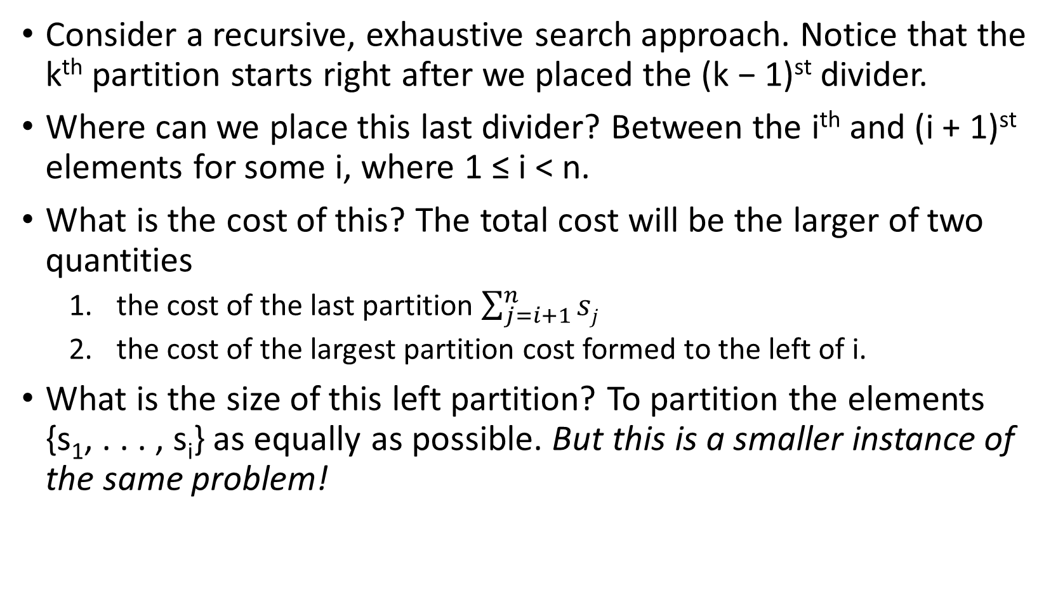
Recursive Idea
Consider a recursive, exhaustive search approach. Notice that the k^{th} partition starts right after we placed the (k − 1)^{st} divider.
Where can we place this last divider? Between the i^{th} and (i + 1)^{st} elements for some i, where 1 ≤ i < n.
What is the cost of this? The total cost will be the larger of two quantities
the cost of the last partition $\sum_{j=i+1}^{n}{sj}$
the cost of the largest partition cost formed to the left of i.
What is the size of this left partition? To partition the elements {s₁, . . . , s_{i}} as equally as possible. But this is a smaller instance of the same problem!

Slide 80
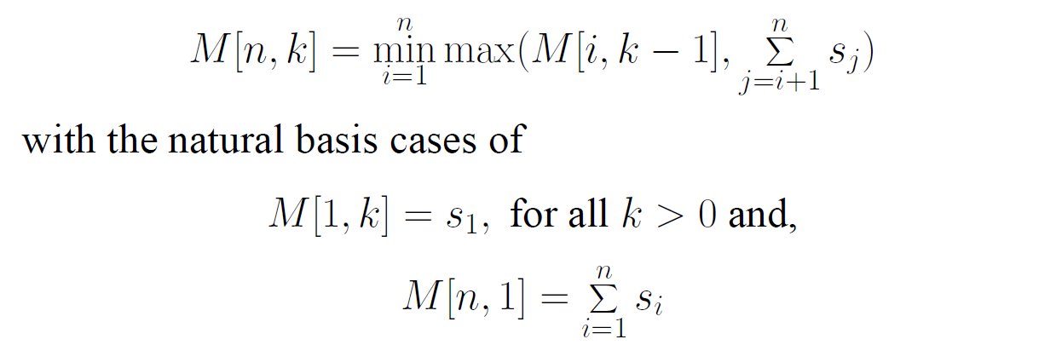
Dynamic Programming Recurrence
Define M[n, k] to be the minimum possible cost over all partitioning of {s₁, . . . , s_{n}} into k ranges, where the cost of a partition is the largest sum of elements in one of its parts. Thus defined, this function can be evaluated:
What is the running time?

Slide 81
It is the number of cells times the running time per cell.
A total of k · n cells exist in the table.
Each cell depends on n others, and can be computed in linear time, for a total of O(kn²).

Slide 82
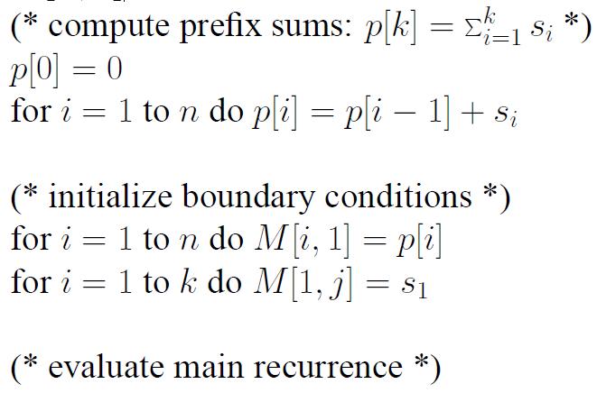
Implementation
To evaluate this efficiently, we must make sure we do the smaller cases before the larger cases that depend upon them.
Partition[S, k]

Slide 83
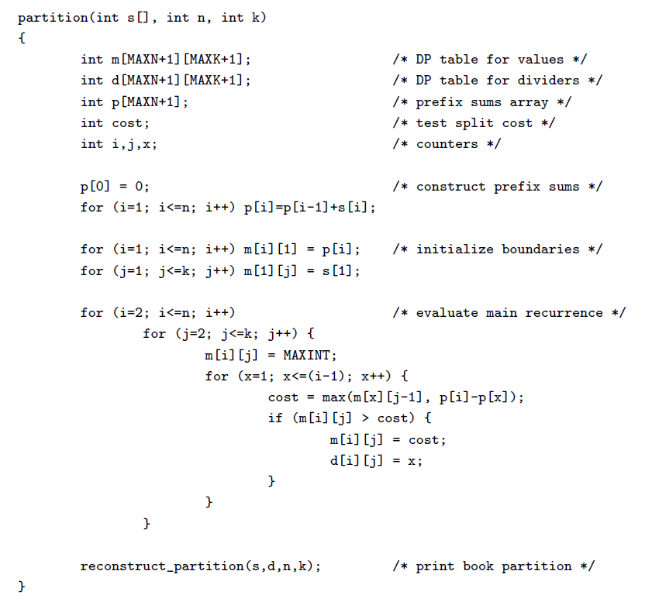

Slide 84
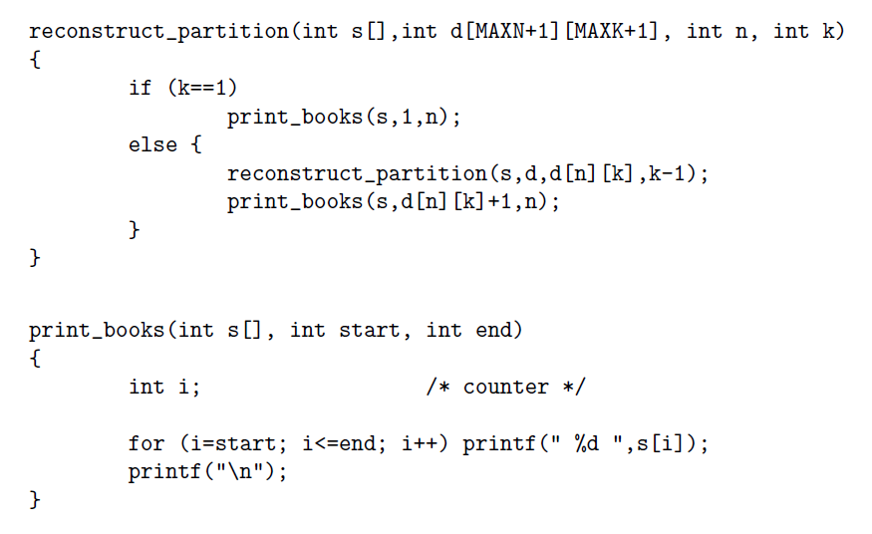

Slide 85
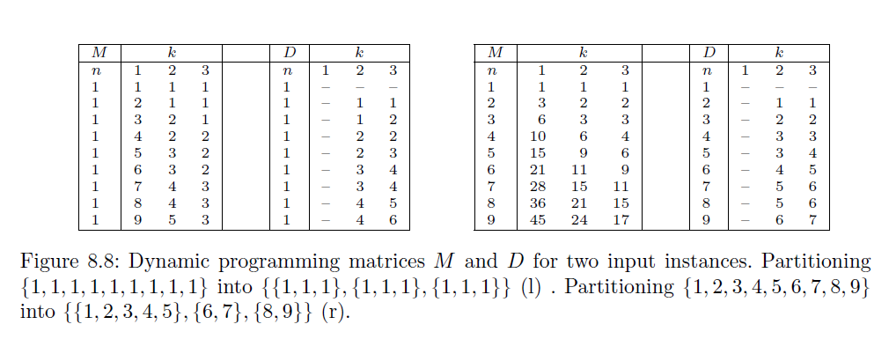

Slide 86
Dynamic Programming … Continued
0-1 Knapsack Problem

Slide 87
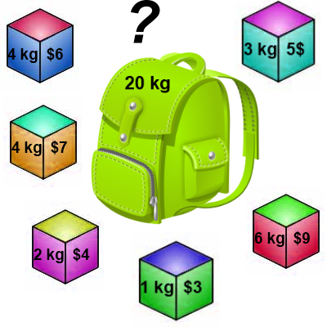
Knapsack 0-1 Problem
The goal is to maximize the value of a knapsack that can hold at most W units (i.e. lbs or kg) worth of goods from a list of items I₀, I₁, … I_{n-1}.
Each item has 2 attributes:
Value – let this be v_{i} for item I_{i}
Weight – let this be w_{i} for item I_{i}

Slide 88
Knapsack 0-1 Problem
The difference between this problem and the fractional knapsack one is that you CANNOT take a fraction of an item.
You can either take it or not.
Hence the name Knapsack 0-1 problem.

Slide 89
Knapsack 0-1 Problem
Brute Force
The naïve way to solve this problem is to cycle through all 2^{n} subsets of the n items and pick the subset with a legal weight that maximizes the value of the knapsack.
We can come up with a dynamic programming algorithm that will USUALLY do better than this brute force technique.

Slide 90
Knapsack 0-1 Problem
As we did before we are going to solve the problem in terms of sub-problems.
So let’s try to do that…
Our first attempt might be to characterize a sub-problem as follows:
Let S_{k} be the optimal subset of elements from {I₀, I₁, …, I_{k}}.
What we find is that the optimal subset from the elements {I₀, I₁, …, I_{k+1}} may not correspond to the optimal subset of elements from {I₀, I₁, …, I_{k}} in any regular pattern.
Basically, the solution to the optimization problem for S_{k+1} might NOT contain the optimal solution from problem S_{k}.

Slide 91
Knapsack 0-1 Problem
Let’s illustrate that point with an example:
Item Weight Value
I₀ 3 10
I₁ 8 4
I₂ 9 9
I₃ 8 11
The maximum weight the knapsack can hold is 20.
The best set of items from {I₀, I₁, I₂} is {I₀, I₁, I₂}
BUT the best set of items from {I₀, I₁, I₂, I₃} is {I₀, I₂, I₃}.
In this example, note that this optimal solution, {I₀, I₂, I₃}, does NOT build upon the previous optimal solution, {I₀, I₁, I₂}.
(Instead it build's upon the solution, {I₀, I₂}, which is really the optimal subset of {I₀, I₁, I₂} with weight 12 or less.)

Slide 92
Knapsack 0-1 problem
So now we must re-work the way we build upon previous sub-problems…
Let B[k, w] represent the maximum total value of a subset S_{k} with weight w.
Our goal is to find B[n, W], where n is the total number of items and W is the maximal weight the knapsack can carry.
So our recursive formula for subproblems:
B[k, w] = B[k - 1,w], if w_{k} > w
= max { B[k - 1,w], B[k - 1,w - w_{k}] + v_{k}}, otherwise
In English, this means that the best subset of S_{k} that has total weight w is:
The best subset of S_{k-1} that has total weight w, or
The best subset of S_{k-1} that has total weight w-w_{k} plus the item k

Slide 93
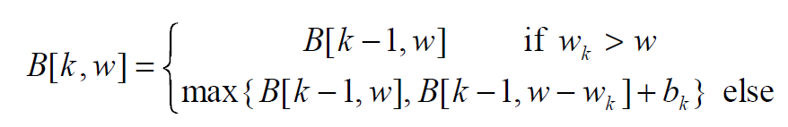
Knapsack 0-1 Problem – Recursive Formula
The best subset of S_{k} that has the total weight w, either contains item k or not.
First case: w_{k} > w
Item k can’t be part of the solution! If it was the total weight would be > w, which is unacceptable.
Second case: w_{k} ≤ w
Then the item k can be in the solution, and we choose the case with greater value.

Slide 94
Knapsack 0-1 Algorithm
for w = 0 to W { // Initialize 1st row to 0’s
B[0,w] = 0
}
for i = 1 to n { // Initialize 1st column to 0’s
B[i,0] = 0
}
for i = 1 to n {
for w = 0 to W {
if w_{i} <= w { //item i can be in the solution
if v_{i} + B[i-1,w-w_{i}] > B[i-1,w]
B[i,w] = v_{i} + B[i-1,w- w_{i}]
else
B[i,w] = B[i-1,w]
}
else B[i,w] = B[i-1,w] // w_{i} > w
}
}

Slide 95
Knapsack 0-1 Problem
Let’s run our algorithm on the following data:
n = 4 (# of elements)
W = 5 (max weight)
Elements (weight, value):
(2,3), (3,4), (4,5), (5,6)

Slide 96
Knapsack 0-1 Example
i / w | 0 | 1 | 2 | 3 | 4 | 5
0 | 0 | 0 | 0 | 0 | 0 | 0
1 | 0
2 | 0
3 | 0
4 | 0
// Initialize the base cases
for w = 0 to W
B[0,w] = 0
for i = 1 to n
B[i,0] = 0

Slide 97
Knapsack 0-1 Example
Items:
1: (2,3)
2: (3,4)
3: (4,5)
4: (5,6)
i / w | 0 | 1 | 2 | 3 | 4 | 5
0 | 0 | 0 | 0 | 0 | 0 | 0
1 | 0
2 | 0
3 | 0
4 | 0
i / w | 0 | 1 | 2 | 3 | 4 | 5
0 | 0 | 0 | 0 | 0 | 0 | 0
1 | 0 | 0
2 | 0
3 | 0
4 | 0
i = 1
v_{i} = 3
w_{i} = 2
w = 1
w-w_{i} = -1
if w_{i} <= w //item i can be in the solution
if v_{i} + B[i-1,w-w_{i}] > B[i-1,w]
B[i,w] = v_{i} + B[i-1,w- w_{i}]
else
B[i,w] = B[i-1,w]
else B[i,w] = B[i-1,w] // w_{i} > w

Slide 98
Knapsack 0-1 Example
Items:
1: (2,3)
2: (3,4)
3: (4,5)
4: (5,6)
i / w | 0 | 1 | 2 | 3 | 4 | 5
0 | 0 | 0 | 0 | 0 | 0 | 0
1 | 0 | 0
2 | 0
3 | 0
4 | 0
i / w | 0 | 1 | 2 | 3 | 4 | 5
0 | 0 | 0 | 0 | 0 | 0 | 0
1 | 0 | 0 | 3
2 | 0
3 | 0
4 | 0
i = 1
v_{i} = 3
w_{i} = 2
w = 2
w-w_{i} = 0
if w_{i} <= w //item i can be in the solution
if v_{i} + B[i-1,w-w_{i}] > B[i-1,w]
B[i,w] = v_{i} + B[i-1,w- w_{i}]
else
B[i,w] = B[i-1,w]
else B[i,w] = B[i-1,w] // w_{i} > w
if w_{i} <= w //item i can be in the solution
if v_{i} + B[i-1,w-w_{i}] > B[i-1,w]
B[i,w] = v_{i} + B[i-1,w- w_{i}]
else
B[i,w] = B[i-1,w]
else B[i,w] = B[i-1,w] // w_{i} > w

Slide 99
Knapsack 0-1 Example
Items:
1: (2,3)
2: (3,4)
3: (4,5)
4: (5,6)
i / w | 0 | 1 | 2 | 3 | 4 | 5
0 | 0 | 0 | 0 | 0 | 0 | 0
1 | 0 | 0 | 3
2 | 0
3 | 0
4 | 0
i / w | 0 | 1 | 2 | 3 | 4 | 5
0 | 0 | 0 | 0 | 0 | 0 | 0
1 | 0 | 0 | 3 | 3
2 | 0
3 | 0
4 | 0
i = 1
v_{i} = 3
w_{i} = 2
w = 3
w-w_{i} = 1
if w_{i} <= w //item i can be in the solution
if v_{i} + B[i-1,w-w_{i}] > B[i-1,w]
B[i,w] = v_{i} + B[i-1,w- w_{i}]
else
B[i,w] = B[i-1,w]
else B[i,w] = B[i-1,w] // w_{i} > w

Slide 100
Knapsack 0-1 Example
Items:
1: (2,3)
2: (3,4)
3: (4,5)
4: (5,6)
i / w | 0 | 1 | 2 | 3 | 4 | 5
0 | 0 | 0 | 0 | 0 | 0 | 0
1 | 0 | 0 | 3 | 3
2 | 0
3 | 0
4 | 0
i / w | 0 | 1 | 2 | 3 | 4 | 5
0 | 0 | 0 | 0 | 0 | 0 | 0
1 | 0 | 0 | 3 | 3 | 3
2 | 0
3 | 0
4 | 0
i = 1
v_{i} = 3
w_{i} = 2
w = 4
w-w_{i} = 2
if w_{i} <= w //item i can be in the solution
if v_{i} + B[i-1,w-w_{i}] > B[i-1,w]
B[i,w] = v_{i} + B[i-1,w- w_{i}]
else
B[i,w] = B[i-1,w]
else B[i,w] = B[i-1,w] // w_{i} > w

Slide 101
Knapsack 0-1 Example
Items:
1: (2,3)
2: (3,4)
3: (4,5)
4: (5,6)
i / w | 0 | 1 | 2 | 3 | 4 | 5
0 | 0 | 0 | 0 | 0 | 0 | 0
1 | 0 | 0 | 3 | 3 | 3
2 | 0
3 | 0
4 | 0
i / w | 0 | 1 | 2 | 3 | 4 | 5
0 | 0 | 0 | 0 | 0 | 0 | 0
1 | 0 | 0 | 3 | 3 | 3 | 3
2 | 0
3 | 0
4 | 0
i = 1
v_{i} = 3
w_{i} = 2
w = 5
w-w_{i} = 3
if w_{i} <= w //item i can be in the solution
if v_{i} + B[i-1,w-w_{i}] > B[i-1,w]
B[i,w] = v_{i} + B[i-1,w- w_{i}]
else
B[i,w] = B[i-1,w]
else B[i,w] = B[i-1,w] // w_{i} > w

Slide 102
Knapsack 0-1 Example
Items:
1: (2,3)
2: (3,4)
3: (4,5)
4: (5,6)
i / w | 0 | 1 | 2 | 3 | 4 | 5
0 | 0 | 0 | 0 | 0 | 0 | 0
1 | 0 | 0 | 3 | 3 | 3 | 3
2 | 0
3 | 0
4 | 0
i / w | 0 | 1 | 2 | 3 | 4 | 5
0 | 0 | 0 | 0 | 0 | 0 | 0
1 | 0 | 0 | 3 | 3 | 3 | 3
2 | 0 | 0
3 | 0
4 | 0
i = 2
v_{i} = 4
w_{i} = 3
w = 1
w-w_{i} = -2
if w_{i} <= w //item i can be in the solution
if v_{i} + B[i-1,w-w_{i}] > B[i-1,w]
B[i,w] = v_{i} + B[i-1,w- w_{i}]
else
B[i,w] = B[i-1,w]
else B[i,w] = B[i-1,w] // w_{i} > w
if w_{i} <= w //item i can be in the solution
if v_{i} + B[i-1,w-w_{i}] > B[i-1,w]
B[i,w] = v_{i} + B[i-1,w- w_{i}]
else
B[i,w] = B[i-1,w]
else B[i,w] = B[i-1,w] // w_{i} > w

Slide 103
Knapsack 0-1 Example
Items:
1: (2,3)
2: (3,4)
3: (4,5)
4: (5,6)
i / w | 0 | 1 | 2 | 3 | 4 | 5
0 | 0 | 0 | 0 | 0 | 0 | 0
1 | 0 | 0 | 3 | 3 | 3 | 3
2 | 0 | 0
3 | 0
4 | 0
i / w | 0 | 1 | 2 | 3 | 4 | 5
0 | 0 | 0 | 0 | 0 | 0 | 0
1 | 0 | 0 | 3 | 3 | 3 | 3
2 | 0 | 0 | 3
3 | 0
4 | 0
i = 2
v_{i} = 4
w_{i} = 3
w = 2
w-w_{i} = -1
if w_{i} <= w //item i can be in the solution
if v_{i} + B[i-1,w-w_{i}] > B[i-1,w]
B[i,w] = v_{i} + B[i-1,w- w_{i}]
else
B[i,w] = B[i-1,w]
else B[i,w] = B[i-1,w] // w_{i} > w

Slide 104
Knapsack 0-1 Example
Items:
1: (2,3)
2: (3,4)
3: (4,5)
4: (5,6)
i / w | 0 | 1 | 2 | 3 | 4 | 5
0 | 0 | 0 | 0 | 0 | 0 | 0
1 | 0 | 0 | 3 | 3 | 3 | 3
2 | 0 | 0 | 3
3 | 0
4 | 0
i / w | 0 | 1 | 2 | 3 | 4 | 5
0 | 0 | 0 | 0 | 0 | 0 | 0
1 | 0 | 0 | 3 | 3 | 3 | 3
2 | 0 | 0 | 3 | 4
3 | 0
4 | 0
i = 2
v_{i} = 4
w_{i} = 3
w = 3
w-w_{i} = 0
if w_{i} <= w //item i can be in the solution
if v_{i} + B[i-1,w-w_{i}] > B[i-1,w]
B[i,w] = v_{i} + B[i-1,w- w_{i}]
else
B[i,w] = B[i-1,w]
else B[i,w] = B[i-1,w] // w_{i} > w
if w_{i} <= w //item i can be in the solution
if v_{i} + B[i-1,w-w_{i}] > B[i-1,w]
B[i,w] = v_{i} + B[i-1,w- w_{i}]
else
B[i,w] = B[i-1,w]
else B[i,w] = B[i-1,w] // w_{i} > w

Slide 105
Knapsack 0-1 Example
Items:
1: (2,3)
2: (3,4)
3: (4,5)
4: (5,6)
i / w | 0 | 1 | 2 | 3 | 4 | 5
0 | 0 | 0 | 0 | 0 | 0 | 0
1 | 0 | 0 | 3 | 3 | 3 | 3
2 | 0 | 0 | 3 | 4
3 | 0
4 | 0
i / w | 0 | 1 | 2 | 3 | 4 | 5
0 | 0 | 0 | 0 | 0 | 0 | 0
1 | 0 | 0 | 3 | 3 | 3 | 3
2 | 0 | 0 | 3 | 4 | 4
3 | 0
4 | 0
i = 2
v_{i} = 4
w_{i} = 3
w = 4
w-w_{i} = 1
if w_{i} <= w //item i can be in the solution
if v_{i} + B[i-1,w-w_{i}] > B[i-1,w]
B[i,w] = v_{i} + B[i-1,w- w_{i}]
else
B[i,w] = B[i-1,w]
else B[i,w] = B[i-1,w] // w_{i} > w

Slide 106
Knapsack 0-1 Example
Items:
1: (2,3)
2: (3,4)
3: (4,5)
4: (5,6)
i / w | 0 | 1 | 2 | 3 | 4 | 5
0 | 0 | 0 | 0 | 0 | 0 | 0
1 | 0 | 0 | 3 | 3 | 3 | 3
2 | 0 | 0 | 3 | 4 | 4
3 | 0
4 | 0
i / w | 0 | 1 | 2 | 3 | 4 | 5
0 | 0 | 0 | 0 | 0 | 0 | 0
1 | 0 | 0 | 3 | 3 | 3 | 3
2 | 0 | 0 | 3 | 4 | 4 | 7
3 | 0
4 | 0
i = 2
v_{i} = 4
w_{i} = 3
w = 5
w-w_{i} = 2
if w_{i} <= w //item i can be in the solution
if v_{i} + B[i-1,w-w_{i}] > B[i-1,w]
B[i,w] = v_{i} + B[i-1,w- w_{i}]
else
B[i,w] = B[i-1,w]
else B[i,w] = B[i-1,w] // w_{i} > w

Slide 107
Knapsack 0-1 Example
Items:
1: (2,3)
2: (3,4)
3: (4,5)
4: (5,6)
i / w | 0 | 1 | 2 | 3 | 4 | 5
0 | 0 | 0 | 0 | 0 | 0 | 0
1 | 0 | 0 | 3 | 3 | 3 | 3
2 | 0 | 0 | 3 | 4 | 4 | 7
3 | 0
4 | 0
i / w | 0 | 1 | 2 | 3 | 4 | 5
0 | 0 | 0 | 0 | 0 | 0 | 0
1 | 0 | 0 | 3 | 3 | 3 | 3
2 | 0 | 0 | 3 | 4 | 4 | 7
3 | 0 | 0 | 3 | 4
4 | 0
i = 3
v_{i} = 5
w_{i} = 4
w = 1..3
w-w_{i} = -3..-1
if w_{i} <= w //item i can be in the solution
if v_{i} + B[i-1,w-w_{i}] > B[i-1,w]
B[i,w] = v_{i} + B[i-1,w- w_{i}]
else
B[i,w] = B[i-1,w]
else B[i,w] = B[i-1,w] // w_{i} > w
if w_{i} <= w //item i can be in the solution
if v_{i} + B[i-1,w-w_{i}] > B[i-1,w]
B[i,w] = v_{i} + B[i-1,w- w_{i}]
else
B[i,w] = B[i-1,w]
else B[i,w] = B[i-1,w] // w_{i} > w

Slide 108
Knapsack 0-1 Example
Items:
1: (2,3)
2: (3,4)
3: (4,5)
4: (5,6)
i / w | 0 | 1 | 2 | 3 | 4 | 5
0 | 0 | 0 | 0 | 0 | 0 | 0
1 | 0 | 0 | 3 | 3 | 3 | 3
2 | 0 | 0 | 3 | 4 | 4 | 7
3 | 0 | 0 | 3 | 4
4 | 0
i / w | 0 | 1 | 2 | 3 | 4 | 5
0 | 0 | 0 | 0 | 0 | 0 | 0
1 | 0 | 0 | 3 | 3 | 3 | 3
2 | 0 | 0 | 3 | 4 | 4 | 7
3 | 0 | 0 | 3 | 4 | 5
4 | 0
i = 3
v_{i} = 5
w_{i} = 4
w = 4
w-w_{i} = 0
if w_{i} <= w //item i can be in the solution
if v_{i} + B[i-1,w-w_{i}] > B[i-1,w]
B[i,w] = v_{i} + B[i-1,w- w_{i}]
else
B[i,w] = B[i-1,w]
else B[i,w] = B[i-1,w] // w_{i} > w
if w_{i} <= w //item i can be in the solution
if v_{i} + B[i-1,w-w_{i}] > B[i-1,w]
B[i,w] = v_{i} + B[i-1,w- w_{i}]
else
B[i,w] = B[i-1,w]
else B[i,w] = B[i-1,w] // w_{i} > w

Slide 109
Knapsack 0-1 Example
Items:
1: (2,3)
2: (3,4)
3: (4,5)
4: (5,6)
i / w | 0 | 1 | 2 | 3 | 4 | 5
0 | 0 | 0 | 0 | 0 | 0 | 0
1 | 0 | 0 | 3 | 3 | 3 | 3
2 | 0 | 0 | 3 | 4 | 4 | 7
3 | 0 | 0 | 3 | 4 | 5
4 | 0
i / w | 0 | 1 | 2 | 3 | 4 | 5
0 | 0 | 0 | 0 | 0 | 0 | 0
1 | 0 | 0 | 3 | 3 | 3 | 3
2 | 0 | 0 | 3 | 4 | 4 | 7
3 | 0 | 0 | 3 | 4 | 5 | 7
4 | 0
i = 3
v_{i} = 5
w_{i} = 4
w = 5
w-w_{i} = 1
if w_{i} <= w //item i can be in the solution
if v_{i} + B[i-1,w-w_{i}] > B[i-1,w]
B[i,w] = v_{i} + B[i-1,w- w_{i}]
else
B[i,w] = B[i-1,w]
else B[i,w] = B[i-1,w] // w_{i} > w
if w_{i} <= w //item i can be in the solution
if v_{i} + B[i-1,w-w_{i}] > B[i-1,w]
B[i,w] = v_{i} + B[i-1,w- w_{i}]
else
B[i,w] = B[i-1,w]
else B[i,w] = B[i-1,w] // w_{i} > w

Slide 110
Knapsack 0-1 Example
Items:
1: (2,3)
2: (3,4)
3: (4,5)
4: (5,6)
i / w | 0 | 1 | 2 | 3 | 4 | 5
0 | 0 | 0 | 0 | 0 | 0 | 0
1 | 0 | 0 | 3 | 3 | 3 | 3
2 | 0 | 0 | 3 | 4 | 4 | 7
3 | 0 | 0 | 3 | 4 | 5 | 7
4 | 0
i / w | 0 | 1 | 2 | 3 | 4 | 5
0 | 0 | 0 | 0 | 0 | 0 | 0
1 | 0 | 0 | 3 | 3 | 3 | 3
2 | 0 | 0 | 3 | 4 | 4 | 7
3 | 0 | 0 | 3 | 4 | 5 | 7
4 | 0 | 0 | 3 | 4 | 5
i = 4
v_{i} = 6
w_{i} = 5
w = 1..4
w-w_{i} = -4..-1
if w_{i} <= w //item i can be in the solution
if v_{i} + B[i-1,w-w_{i}] > B[i-1,w]
B[i,w] = v_{i} + B[i-1,w- w_{i}]
else
B[i,w] = B[i-1,w]
else B[i,w] = B[i-1,w] // w_{i} > w
if w_{i} <= w //item i can be in the solution
if v_{i} + B[i-1,w-w_{i}] > B[i-1,w]
B[i,w] = v_{i} + B[i-1,w- w_{i}]
else
B[i,w] = B[i-1,w]
else B[i,w] = B[i-1,w] // w_{i} > w

Slide 111
Knapsack 0-1 Example
Items:
1: (2,3)
2: (3,4)
3: (4,5)
4: (5,6)
i / w | 0 | 1 | 2 | 3 | 4 | 5
0 | 0 | 0 | 0 | 0 | 0 | 0
1 | 0 | 0 | 3 | 3 | 3 | 3
2 | 0 | 0 | 3 | 4 | 4 | 7
3 | 0 | 0 | 3 | 4 | 5 | 7
4 | 0 | 0 | 3 | 4 | 5
i / w | 0 | 1 | 2 | 3 | 4 | 5
0 | 0 | 0 | 0 | 0 | 0 | 0
1 | 0 | 0 | 3 | 3 | 3 | 3
2 | 0 | 0 | 3 | 4 | 4 | 7
3 | 0 | 0 | 3 | 4 | 5 | 7
4 | 0 | 0 | 3 | 4 | 5 | 7
i = 4
v_{i} = 6
w_{i} = 5
w = 5
w-w_{i} = 0
if w_{i} <= w //item i can be in the solution
if v_{i} + B[i-1,w-w_{i}] > B[i-1,w]
B[i,w] = v_{i} + B[i-1,w- w_{i}]
else
B[i,w] = B[i-1,w]
else B[i,w] = B[i-1,w] // w_{i} > w
if w_{i} <= w //item i can be in the solution
if v_{i} + B[i-1,w-w_{i}] > B[i-1,w]
B[i,w] = v_{i} + B[i-1,w- w_{i}]
else
B[i,w] = B[i-1,w]
else B[i,w] = B[i-1,w] // w_{i} > w

Slide 112
Knapsack 0-1 Example
Items:
1: (2,3)
2: (3,4)
3: (4,5)
4: (5,6)
i / w | 0 | 1 | 2 | 3 | 4 | 5
0 | 0 | 0 | 0 | 0 | 0 | 0
1 | 0 | 0 | 3 | 3 | 3 | 3
2 | 0 | 0 | 3 | 4 | 4 | 7
3 | 0 | 0 | 3 | 4 | 5 | 7
4 | 0 | 0 | 3 | 4 | 5 | 7
We’re DONE!!
The max possible value that can be carried in this knapsack is $7

Slide 113
Knapsack 0-1 Algorithm
This algorithm only finds the max possible value that can be carried in the knapsack
The value in B[n,W]
To know the items that make this maximum value, we need to trace back through the table.

Slide 114
Knapsack 0-1 Algorithm Finding the Items
Let i = n and k = W
if B[i, k] ≠ B[i-1, k] then
mark the i^{th} item as in the knapsack
i = i-1, k = k-w_{i}
else
i = i-1 // Assume the i^{th} item is not in the knapsack
// Could it be in the optimally packed knapsack?

Slide 115
Knapsack 0-1 Algorithm Finding the Items
Items:
1: (2,3)
2: (3,4)
3: (4,5)
4: (5,6)
Knapsack:
i / w | 0 | 1 | 2 | 3 | 4 | 5
0 | 0 | 0 | 0 | 0 | 0 | 0
1 | 0 | 0 | 3 | 3 | 3 | 3
2 | 0 | 0 | 3 | 4 | 4 | 7
3 | 0 | 0 | 3 | 4 | 5 | 7
4 | 0 | 0 | 3 | 4 | 5 | 7
i = 4
k = 5
v_{i} = 6
w_{i} = 5
B[i,k] = 7
B[i-1,k] = 7
i = n , k = W
while i, k > 0
if B[i, k] ≠ B[i-1, k] then
mark the i^{th} item as in the knapsack
i = i-1, k = k-w_{i}
else
i = i-1

Slide 116
Knapsack 0-1 Algorithm Finding the Items
Items:
1: (2,3)
2: (3,4)
3: (4,5)
4: (5,6)
Knapsack:
i / w | 0 | 1 | 2 | 3 | 4 | 5
0 | 0 | 0 | 0 | 0 | 0 | 0
1 | 0 | 0 | 3 | 3 | 3 | 3
2 | 0 | 0 | 3 | 4 | 4 | 7
3 | 0 | 0 | 3 | 4 | 5 | 7
4 | 0 | 0 | 3 | 4 | 5 | 7
i = 3
k = 5
v_{i} = 5
w_{i} = 4
B[i,k] = 7
B[i-1,k] = 7
i = n , k = W
while i, k > 0
if B[i, k] ≠ B[i-1, k] then
mark the i^{th} item as in the knapsack
i = i-1, k = k-w_{i}
else
i = i-1

Slide 117
Knapsack 0-1 Algorithm Finding the Items
Items:
1: (2,3)
2: (3,4)
3: (4,5)
4: (5,6)
Knapsack:
Item 2
i / w | 0 | 1 | 2 | 3 | 4 | 5
0 | 0 | 0 | 0 | 0 | 0 | 0
1 | 0 | 0 | 3 | 3 | 3 | 3
2 | 0 | 0 | 3 | 4 | 4 | 7
3 | 0 | 0 | 3 | 4 | 5 | 7
4 | 0 | 0 | 3 | 4 | 5 | 7
i = 2
k = 5
v_{i} = 4
w_{i} = 3
B[i,k] = 7
B[i-1,k] = 3
k – w_{i} = 2
i = n , k = W
while i, k > 0
if B[i, k] ≠ B[i-1, k] then
mark the i^{th} item as in the knapsack
i = i-1, k = k-w_{i}
else
i = i-1

Slide 118
Knapsack 0-1 Algorithm Finding the Items
Items:
1: (2,3)
2: (3,4)
3: (4,5)
4: (5,6)
Knapsack:
Item 2
Item 1
i / w | 0 | 1 | 2 | 3 | 4 | 5
0 | 0 | 0 | 0 | 0 | 0 | 0
1 | 0 | 0 | 3 | 3 | 3 | 3
2 | 0 | 0 | 3 | 4 | 4 | 7
3 | 0 | 0 | 3 | 4 | 5 | 7
4 | 0 | 0 | 3 | 4 | 5 | 7
i = 1
k = 2
v_{i} = 3
w_{i} = 2
B[i,k] = 3
B[i-1,k] = 0
k – w_{i} = 0
i = n , k = W
while i, k > 0
if B[i, k] ≠ B[i-1, k] then
mark the i^{th} item as in the knapsack
i = i-1, k = k-w_{i}
else
i = i-1

Slide 119
Knapsack 0-1 Algorithm Finding the Items
Items:
1: (2,3)
2: (3,4)
3: (4,5)
4: (5,6)
Knapsack:
Item 2
Item 1
i / w | 0 | 1 | 2 | 3 | 4 | 5
0 | 0 | 0 | 0 | 0 | 0 | 0
1 | 0 | 0 | 3 | 3 | 3 | 3
2 | 0 | 0 | 3 | 4 | 4 | 7
3 | 0 | 0 | 3 | 4 | 5 | 7
4 | 0 | 0 | 3 | 4 | 5 | 7
i = 1
k = 2
v_{i} = 3
w_{i} = 2
B[i,k] = 3
B[i-1,k] = 0
k – w_{i} = 0
k = 0, so we’re DONE!
The optimal knapsack should contain:
Item 1 and Item 2

Slide 120
Knapsack 0-1 Problem – Run Time
for w = 0 to W
B[0,w] = 0
for i = 1 to n
B[i,0] = 0
for i = 1 to n
for w = 0 to W
< the rest of the code >
What is the running time of this algorithm?
O(n*W)
Remember that the brute-force algorithm takes: O(2^{n})
O(W)
O(n)
Repeat n times
O(W)

Slide 121
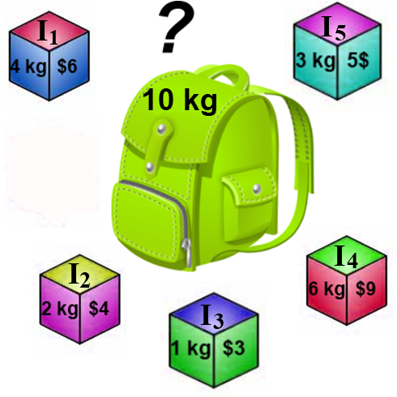
Knapsack Problem
Fill out the dynamic programming table for the knapsack problem to the right.
Trace back through the table to find the items in the knapsack.

Slide 122
References
Slides adapted from Arup Guha’s Computer Science II Lecture notes: http://www.cs.ucf.edu/~dmarino/ucf/cop3503/lectures/
Additional material from the textbook:
Data Structures and Algorithm Analysis in Java (Second Edition) by Mark Allen Weiss
Additional images:
www.wikipedia.com
xkcd.com

Slide 123
Limitation of Dynamic Programming

Slide 124
Introduction
DP doesn’t always work
Recognizing the application for which DP doesn’t work is important
Let’s take an example:
Longest simple path
I/P: A weighted graph with the start and end vertices s and t.
O/P: Most expensive path between s and t which does not visit any vertex more than one (simple path)

Slide 125
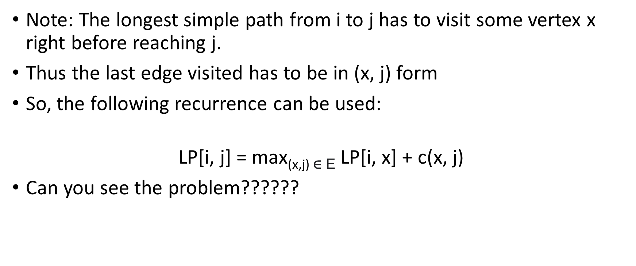
Use DP for Longest simple path
Note: The longest simple path from i to j has to visit some vertex x right before reaching j.
Thus the last edge visited has to be in (x, j) form
So, the following recurrence can be used:
$$\text{LP}\text{[}\text{i}\text{, }\text{j}\text{] = }\text{max}\text{(}\text{x}\text{,}\text{j}\text{) }\text{∈ }\text{E} \text{LP}\text{[}\text{i}\text{, }\text{x}\text{] + }\text{c}\text{(}\text{x}\text{, }\text{j}\text{)}$$
Can you see the problem??????

Slide 126

$$\text{LP}\text{[}\text{i}\text{, }\text{j}\text{] = }\text{max}\text{(}\text{x}\text{,}\text{j}\text{) }\text{∈ }\text{E} \text{LP}\text{[}\text{i}\text{, }\text{x}\text{] + }\text{c}\text{(}\text{x}\text{, }\text{j}\text{)}$$
There are two problems in the above recursive solution
The recursion does nothing to enforce simplicity (No loop in the path)
The evaluation order (based on bigger-smaller, left-right, etc) is not clear so difficult to defined the sub problem.

Slide 127
When DP Can Be Used?
Dynamic programming can be applied to any problem that observes the principle of optimality.
principle of optimality: The partial solutions can be optimally extended with regard to the state after the partial solution, instead of the specifics of the partial solution itself.
For example, in deciding whether to extend an approximate string matching by a substitution, insertion, or deletion, we did not need to know which sequence of operations had been performed to date.
There may be several different edit sequences that achieve a cost of C on the first p characters of pattern P and t characters of string T. Future decisions are made based on the consequences of previous decisions, not the actual decisions themselves.
Problems do not satisfy the principle of optimality when the specifics of the operations matter, as opposed to just the cost of the operations.

Slide 128
The running time of any dynamic programming algorithm is a function of two things:
(1) number of partial solutions we must keep track of, and
(2) how long it take to evaluate each partial solution.
The first issue—namely the size of the state space—is usually the more pressing concern.
In all of the examples we have seen, the partial solutions are completely described by specifying the stopping places in the input.
This is because the combinatorial objects being worked on (strings, numerical sequences, and polygons) have an implicit order defined upon their elements.
When the objects are not firmly ordered, however, we get an exponential number of possible partial solutions.
Without an inherent left-to-right ordering on the objects, dynamic programming is usually doomed to require exponential space and time.

